Slide 1

Bioinformatics Bootcamp
Special Topic Workshop: “Single Cell RNA-Seq Analysis”
Module 1: Orientation and Review of R and RNA-Seq Analysis

Slide 2
Workshop Orientation

Slide 3
Why a workshop?
Those who know bioinformatics will be…
More effective at research
More competitive for jobs/funding
More flexible/adaptable to changes in their field
There is tremendous interest in formal bioinformatics training... yet, opportunities for such training are sparse.
Solution: Provide training as a weekly workshop open to all!

Slide 4
Workshop Structure
Most sessions will be roughly 50:50 lecture and hands-on activities.

Slide 5
Workshop Structure
Most sessions will be roughly 50:50 lecture and hands-on activities.
***Lectures will be recorded***

Slide 6
Workshop Structure
Most sessions will be roughly 50:50 lecture and hands-on activities.
***Lectures will be recorded***
Outline
Module 1: Orientation and Review of R/RNA-Seq analysis
Module 2: Prepping scRNA-Seq data for analysis
Module 3: Uncovering dataset structure with manifold learning
Module 4: scRNA-Seq biological interpretation
Module 5: Advanced topics in single cell analysis
Module 6: Final Project (finding tumor metastatic subpopulations)

Slide 7
Learning goals and objectives
From this workshop, you will learn how to:
Perform basic scRNA-Seq data preparation.

Slide 8
Learning goals and objectives
From this workshop, you will learn how to:
Perform basic scRNA-Seq data preparation.
Use manifold learning techniques to analyze cellular relationships in scRNA-Seq data.

Slide 9
Learning goals and objectives
From this workshop, you will learn how to:
Perform basic scRNA-Seq data preparation.
Use manifold learning techniques to analyze cellular relationships in scRNA-Seq data.
Find and interpret biologically-meaningful patterns in scRNA-Seq data.

Slide 10
Learning goals and objectives
From this workshop, you will learn how to:
Perform basic scRNA-Seq data preparation.
Use manifold learning techniques to analyze cellular relationships in scRNA-Seq data.
Find and interpret biologically-meaningful patterns in scRNA-Seq data.
Integrate single cell data from multiple batches, studies, or modalities.

Slide 11
Learning goals and objectives
From this workshop, you will learn how to:
Perform basic scRNA-Seq data preparation.
Use manifold learning techniques to analyze cellular relationships in scRNA-Seq data.
Find and interpret biologically-meaningful patterns in scRNA-Seq data.
Integrate single cell data from multiple batches, studies, or modalities.
Present the results of scRNA-Seq analyses with publication-quality figures.

Slide 12
Learning goals and objectives
From this workshop, you will learn how to:
Perform basic scRNA-Seq data preparation.
Use manifold learning techniques to analyze cellular relationships in scRNA-Seq data.
Find and interpret biologically-meaningful patterns in scRNA-Seq data.
Integrate single cell data from multiple batches, studies, or modalities.
Present the results of scRNA-Seq analyses with publication-quality figures.
By the end, you will gain the skills and confidence to use scRNA-Seq analysis in your research.

Slide 13
How to succeed in this workshop
Respect the prerequisites.

Slide 14
How to succeed in this workshop
Respect the prerequisites.
Basic familiarity with readr, dplyr, ggplot2, programming concepts (for-loops, if…else, etc), and DESeq2 is expected.

Slide 15
How to succeed in this workshop
Respect the prerequisites.
Basic familiarity with readr, dplyr, ggplot2, programming concepts (for-loops, if…else, etc), and DESeq2 is expected.
You can catch up on these concepts by reviewing Fall 2020 R Programming and RNA-Seq analysis BIG club workshop (link)

Slide 16
How to succeed in this workshop
Respect the prerequisites.
Basic familiarity with readr, dplyr, ggplot2, programming concepts (for-loops, if…else, etc), and DESeq2 is expected.
You can catch up on these concepts by reviewing Fall 2020 R Programming and RNA-Seq analysis BIG club workshop (link)
Use DataCamp Classroom and pursue outside learning (e.g., codecademy, RStudio books, etc)

Slide 17
How to succeed in this workshop
Respect the prerequisites.
Basic familiarity with readr, dplyr, ggplot2, programming concepts (for-loops, if…else, etc), and DESeq2 is expected.
You can catch up on these concepts by reviewing Fall 2020 R Programming and RNA-Seq analysis BIG club workshop (link)
Use DataCamp Classroom and pursue outside learning (e.g., codecademy, RStudio books, etc)
Communicate with your instructors
Email any time and attend Zoom office hours (listed in the syllabus)

Slide 18
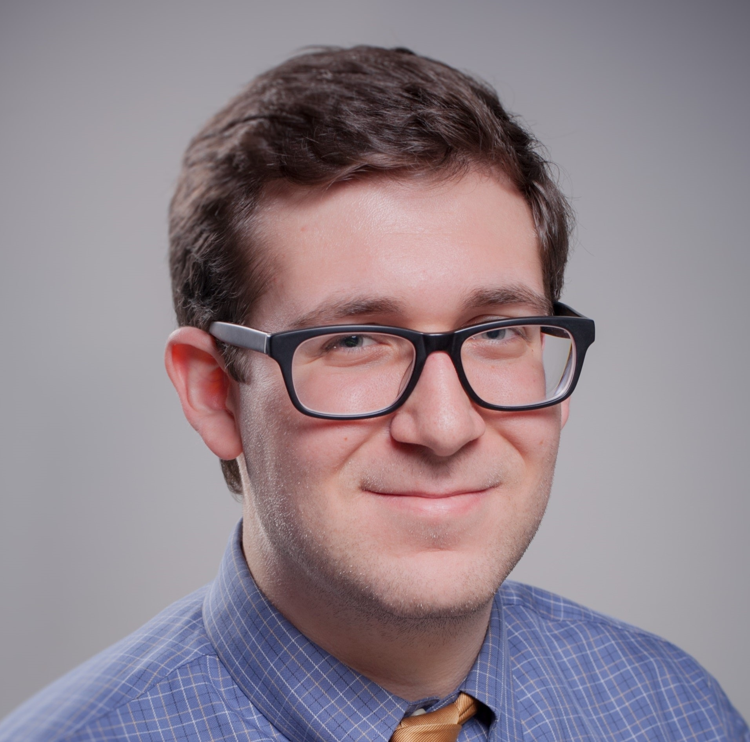
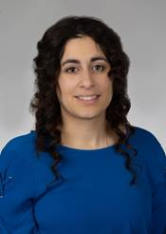
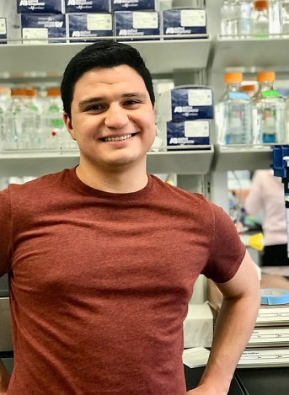
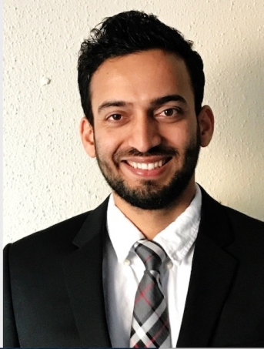
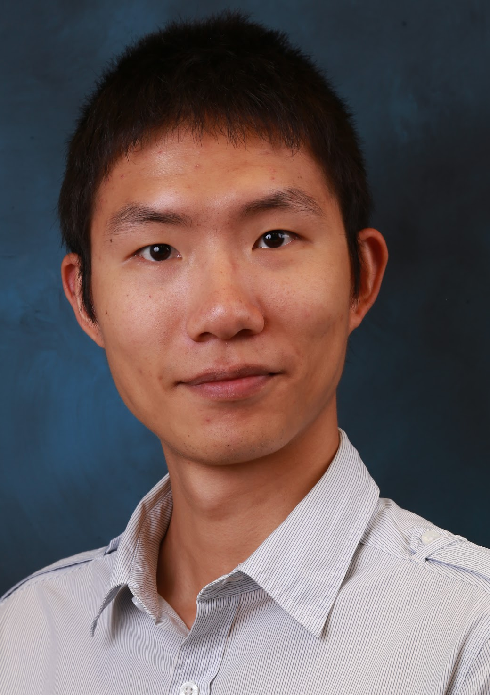
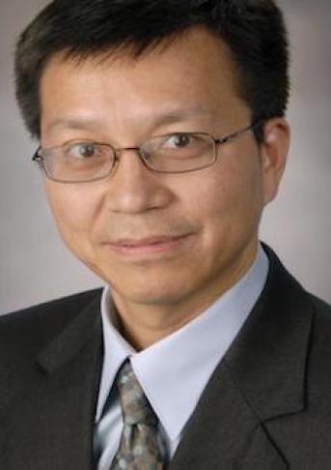
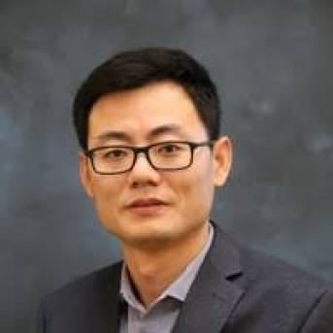
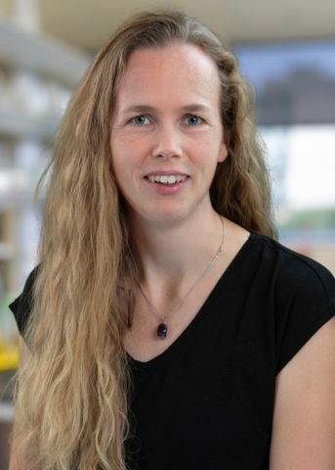
Bioinformatics Bootcamp Instructors
Student Instructors and TAs
Henry Miller
Victoria Alers
Paul Ramirez
Muku Bhandari
Faculty and Staff instructors
Dr. Chris Chiu
Dr. Yidong Chen
Dr. Siyuan Zheng
Dr. Evelien Bunnik

Slide 19

About BIG club
Bioinformatics Interest Group (BIG) is a new UT Health SA club promoting student engagement with bioinformatics.
Leadership
President: Muku Bhandari
Vice President: Victoria Alers
Secretary: Paul Ramirez
Training committee chair: Henry Miller
Historian: Aiola Stoja
Treasurer: Meilinn Tram
All UT Health SA students are welcome to join our first meeting next Tuesday Sept 8th from 6:30-7:30pm.

Slide 20
Background
Bulk and Single Cell RNA-Seq

Slide 21
RNA-Seq profiles mRNA in different conditions:
Tissue type
Cell type
Drug treatment
Disease
Survival
Genotype
Age
Development stage
Etc…
Elucidated by RNA-Sequencing
Gene expression
Splicing
Gene fusions
Transposon expression

Slide 22
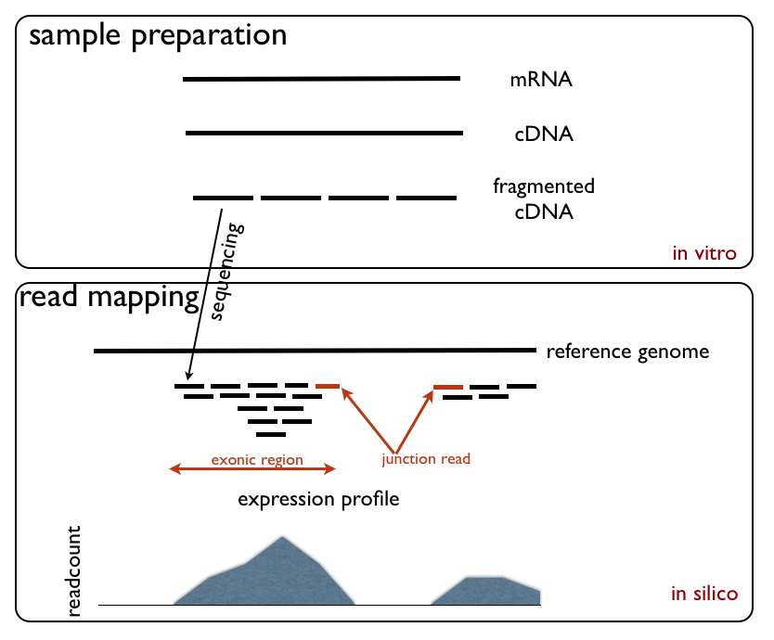
RNA-Sequencing steps
https://upload.wikimedia.org/wikipedia/commons/d/db/RNA_Seq_Experiment.png

Slide 23
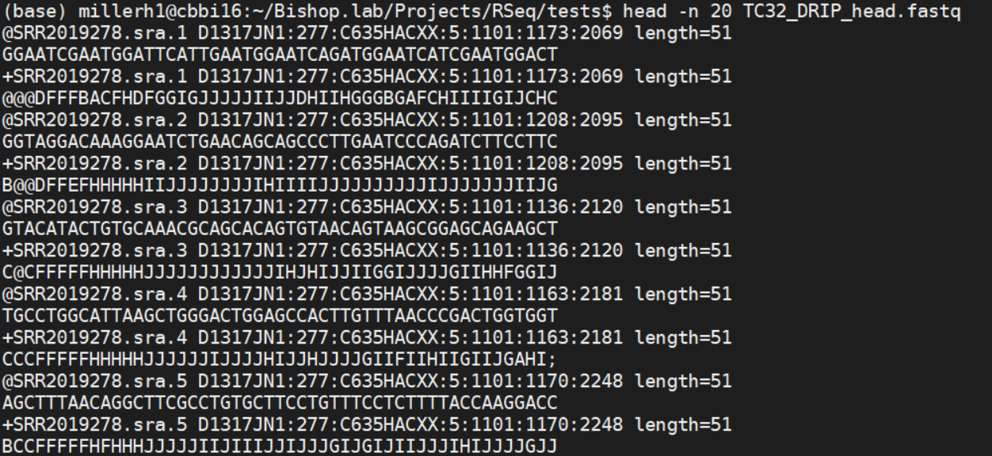
Read 1
Read 2
Read 3

Slide 24
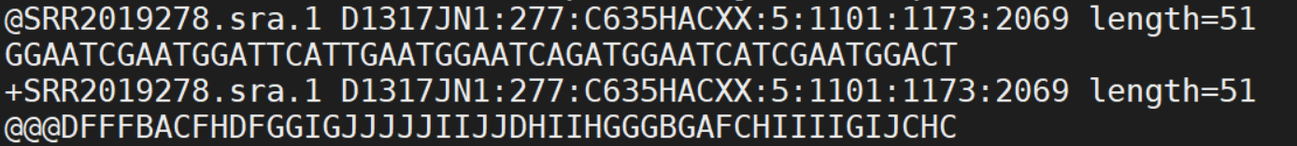
Read ID + sequencing info
GCAT sequence
Placeholder
Quality score of each base

Slide 25
RNA-Sequencing steps
https://upload.wikimedia.org/wikipedia/commons/d/db/RNA_Seq_Experiment.png

Slide 26
RNA-Sequencing steps
https://upload.wikimedia.org/wikipedia/commons/d/db/RNA_Seq_Experiment.png

Slide 27
RNA-seq alignment
RNA-seq typically only looks coding region
Read counts summaried across all exons
Reads over intron/promote regions commonly are NOT coounted
RNA-seq may be extended to cover
Non-coding RNAs (Functional elements)
Small RNAs, etc
5’
3’
TSS
Promoter
Exon
Exon
Coding sequence (CDS)
Intron
Intergenic region

Slide 28
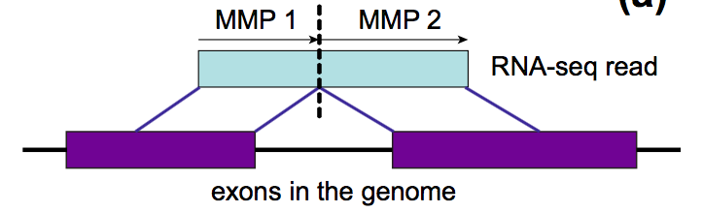
RNA-Seq detects splicing
https://galaxyproject.org/tutorials/rb_rnaseq/

Slide 29
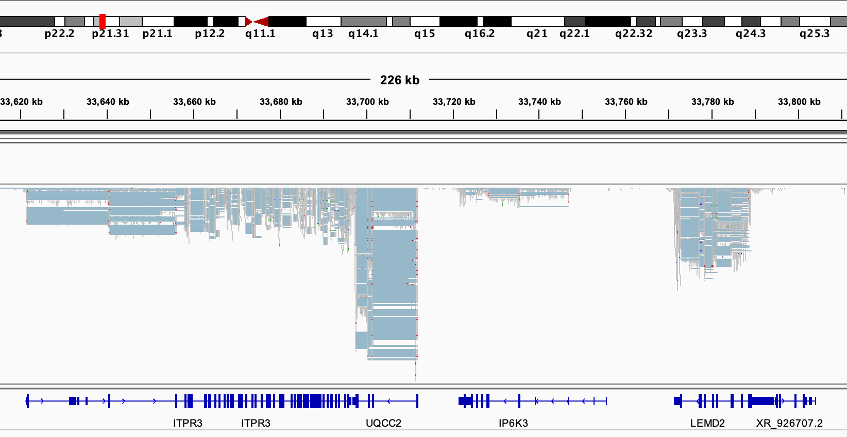

Slide 30
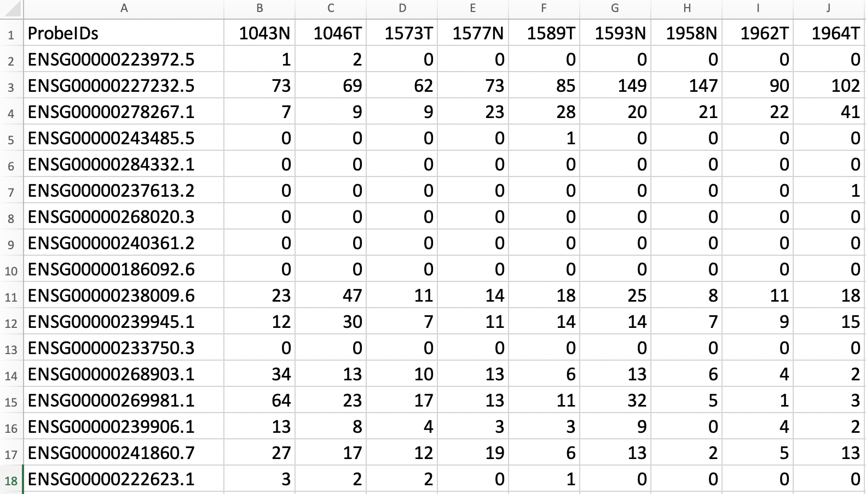
RNA-seq data example
Gene ID
# of sequence reads aligned to this gene
Sample name
35k + rows

Slide 31
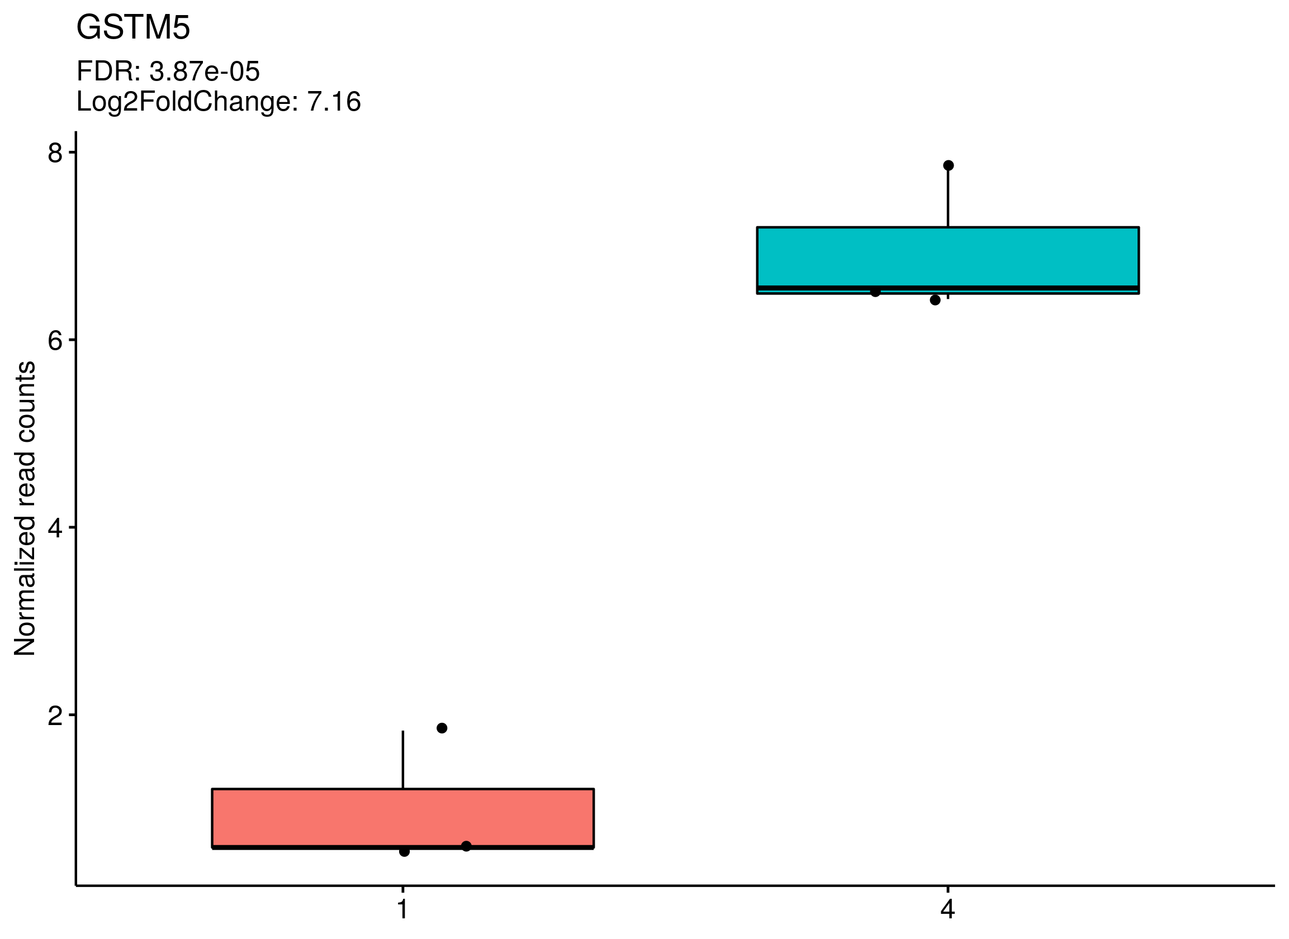
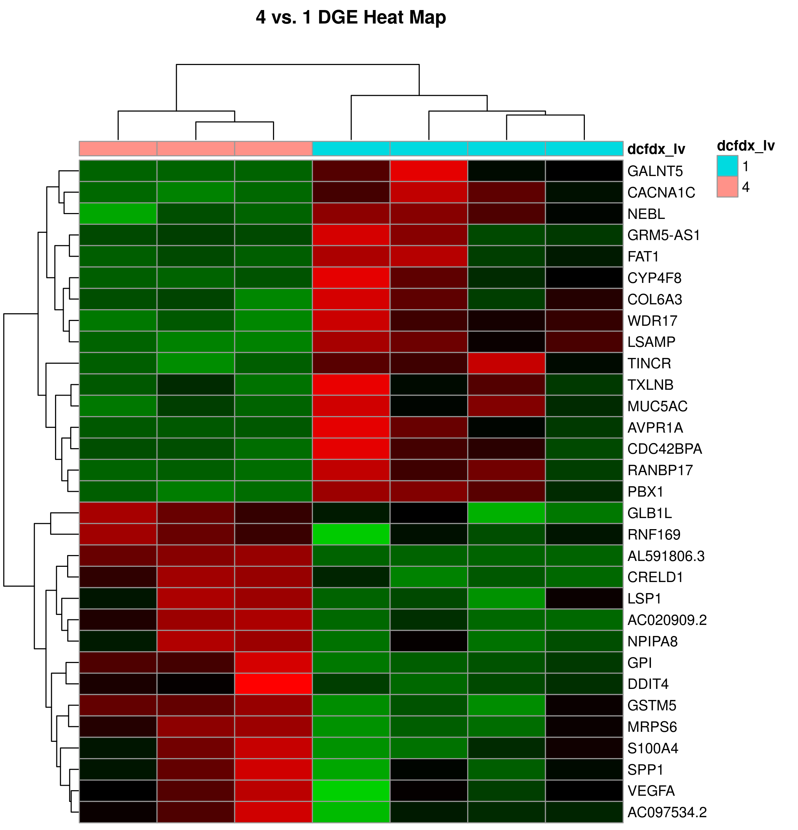
RNA-Seq can detect changes between samples
AD
NCI
NCI
AD

Slide 32
RNA-Seq can detect changes between samples
Questions we can answer:
Pathways overexpressed?
Biological processes overexpressed?
New drug targets?
Gene expression patterns associated with survival?
Gene expression patterns associated with genotypes?
AD
NCI
NCI
AD

Slide 33
RNA-Seq can detect changes between samples
Questions we can answer:
Pathways overexpressed?
Biological processes overexpressed?
New drug targets?
Gene expression patterns associated with survival?
Gene expression patterns associated with genotypes?
Questions we cannot answer:
How do cellular populations change in AD vs NCI?
Do all cell types show the same differential expression?
Are there cell subpopulations which are capable of surviving? Are there vulnerable subpopulations?
AD
NCI
NCI
AD

Slide 34
RNA sequencing cannot resolve heterogeneity within complex samples
Sorted patient cells
Post-mortem tissues
Transfected cells
Clonal cell populations
Organoids
Tumor biopsies
Cell lines
Homogenous
Heterogenous
Suitability for bulk RNA-Seq

Slide 35
Single-cell RNA Seq: every cell is a unique sample
https://community.10xgenomics.com/t5/10x-Blog/Single-Cell-RNA-Seq-An-Introductory-Overview-and-Tools-for/ba-p/547

Slide 36
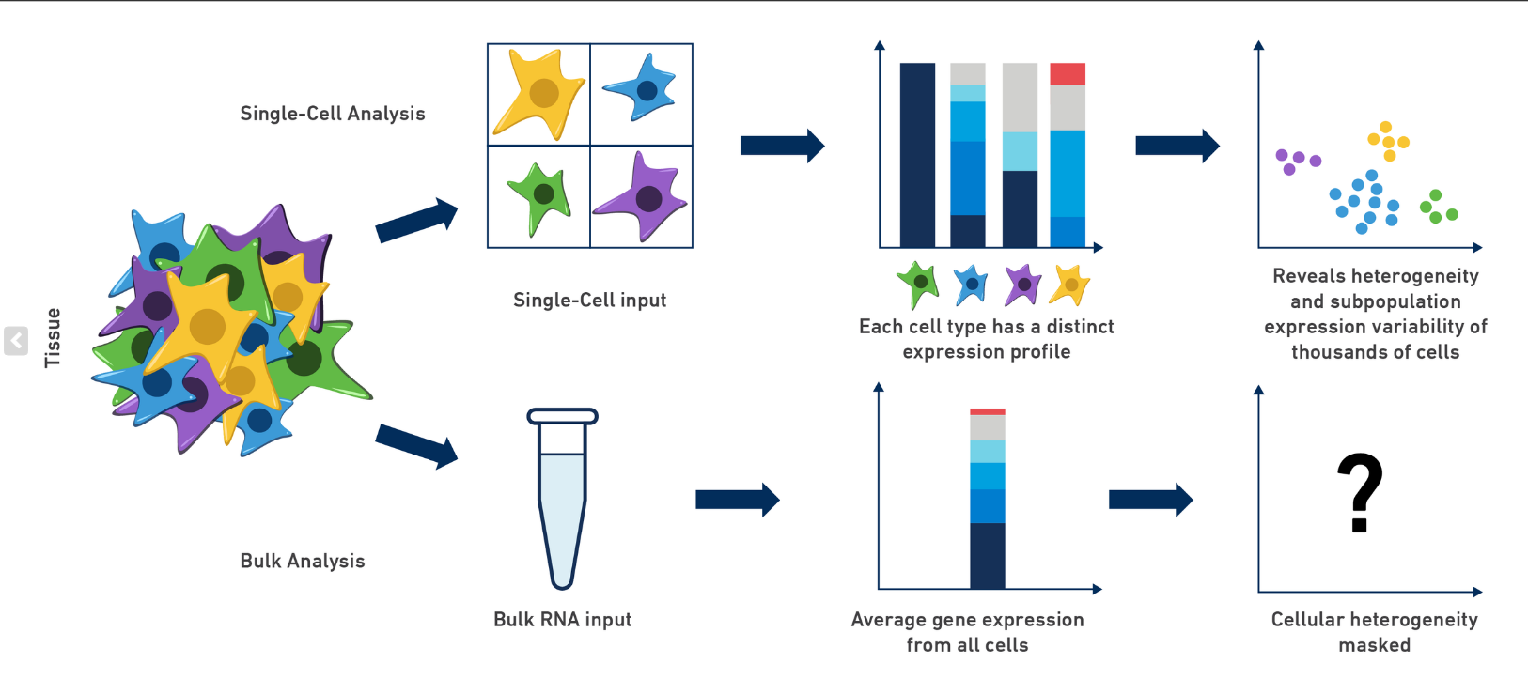
Single-cell RNA Seq: every cell is a unique sample
https://community.10xgenomics.com/t5/10x-Blog/Single-Cell-RNA-Seq-An-Introductory-Overview-and-Tools-for/ba-p/547

Slide 37
scRNA-Seq data matrix
35k + rows
315k+ data points

Slide 38
scRNA-Seq data matrix
8000+ columns
35k + rows

Slide 39
scRNA-Seq data matrix
8000+ columns
35k + rows
280m+ data points

Slide 40
Single-cell transcriptomic analysis of Alzheimer’s disease
Mathys et al. 2019

Slide 41
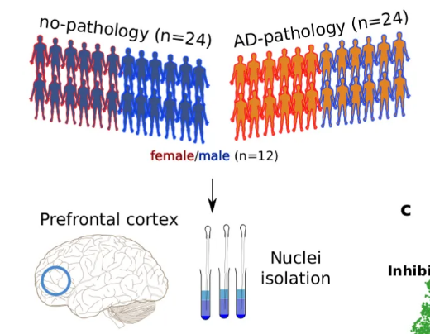
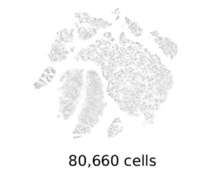
Single-cell RNA-Seq of AD brains

Slide 42
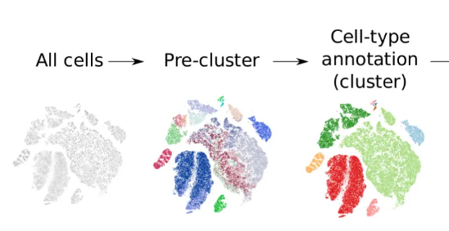
Cells with similar genome-wide mRNA expression will cluster together

Slide 43
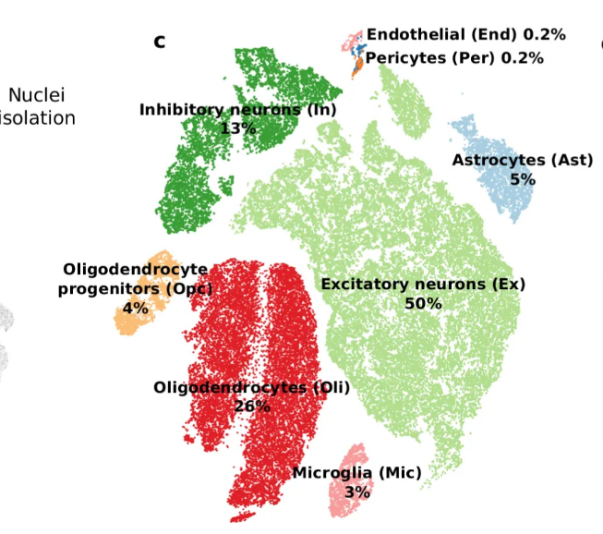
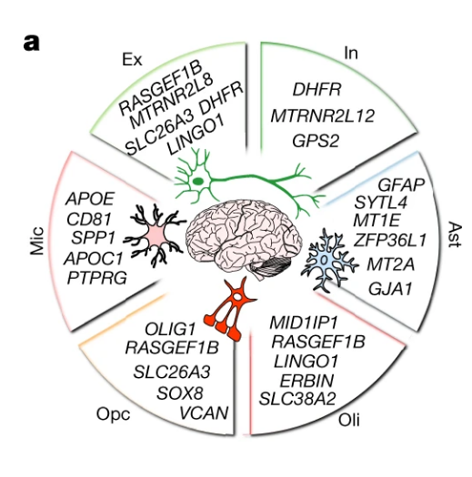
Cell-identity expression markers identify clusters

Slide 44
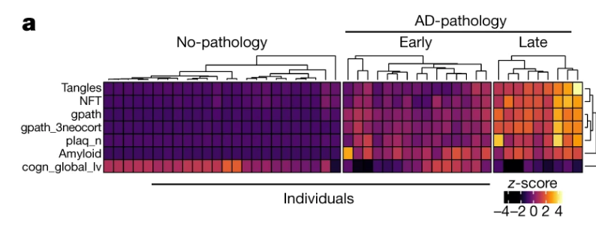
Analysis of DEGs by AD stage

Slide 45
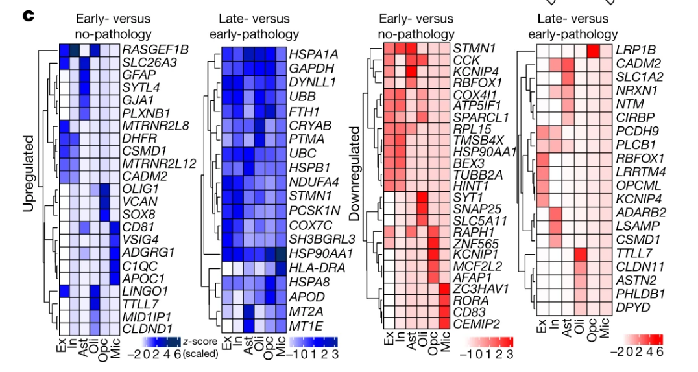
Analysis of DEGs by AD stage

Slide 46
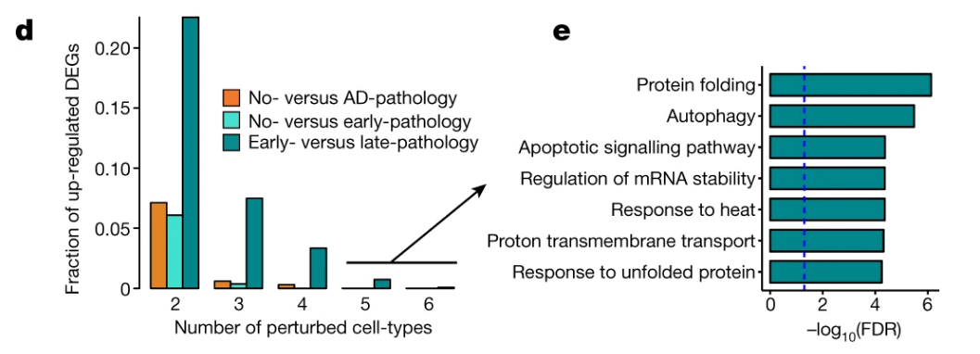
Analysis of DEGs by AD stage

Slide 47
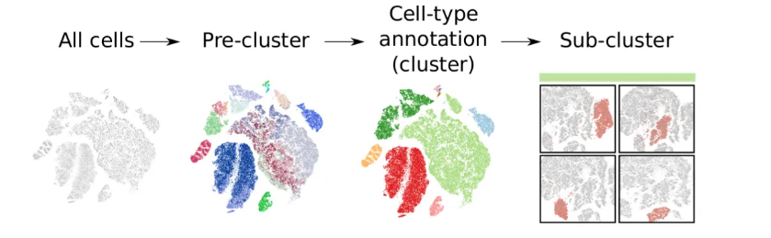
Sub-clustering predicts smaller cell groups within a broader cell type

Slide 48
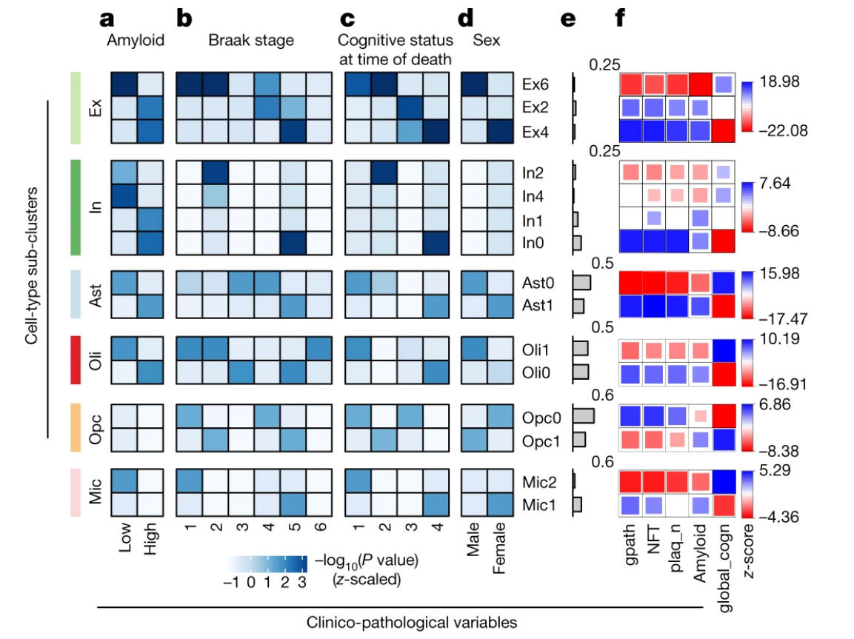
Sub-clusters form based on the disease status and sex of patients

Slide 49
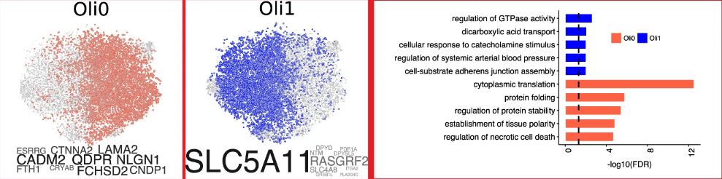
Sub-clusters many AD cells show differences in gene expression
High AD population
Low AD population

Slide 50
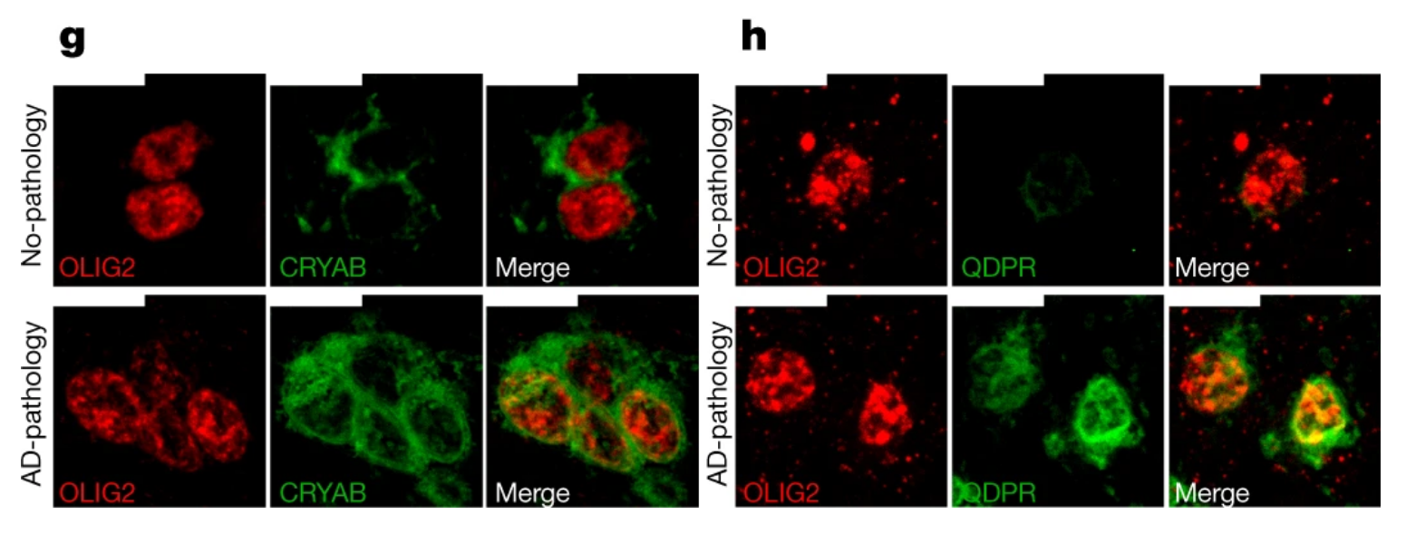
Predicted oligodendrocyte AD sub-cluster confirmed by IHC

Slide 51
Summary
ROSMAP is a comprehensive atlas of brain aging and AD
RNA-Sequencing reveals differences between samples
Single-cell/nucleus RNA-Seq reveals cell-level differences
Cellular subpopulations in multiple cell types show pathology between AD and NCI patients
DEGs represent interesting biological themes (UPR, oxidative stress, etc.)
This is a resource for generating new hypotheses that has yet to be explored in-depth. (Example)

